Slide 1
Install Hadoop on Mac

Slide 2
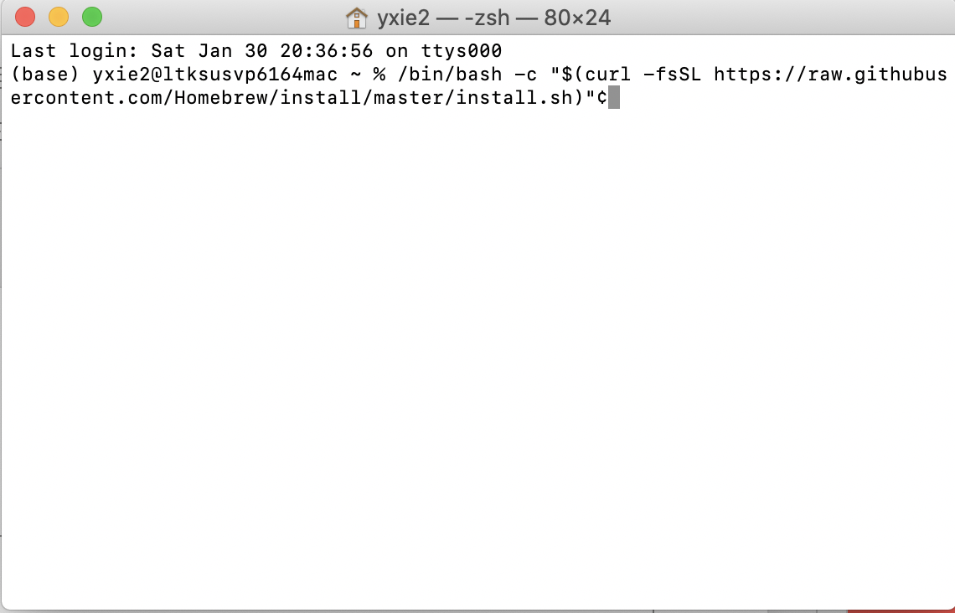
Install HomeBrew
/bin/bash -c "$(curl -fsSL https://raw.githubusercontent.com/Homebrew/install/master/install.sh)"
Press RETURN to imitate the process. The process may take 10 minutes, patiently wait till you see command prompt again.

Slide 3
Install Java 8
Use the following command to check your existing Java version
$ java –version
If you don’t have java, or your java version is not 1.8, you need to install jdk 1.8.
Issue the following command to install Java 8, like is shown in the following screenshot.
$ brew install --cast homebrew/cask-versions/adoptopenjdk8

Slide 4
Install Hadoop
Use the following command to install the most current version of Hadoop at the path /usr/local/Cellar/hadoop
$ brew install hadoop

Slide 5
Configure Hadoop
Use the following command to open hadoop-env.sh
$ cd /usr/local/cellar/hadoop/3.3.0/libexec/etc/hadoop $ open hadoop-env.sh

Slide 6
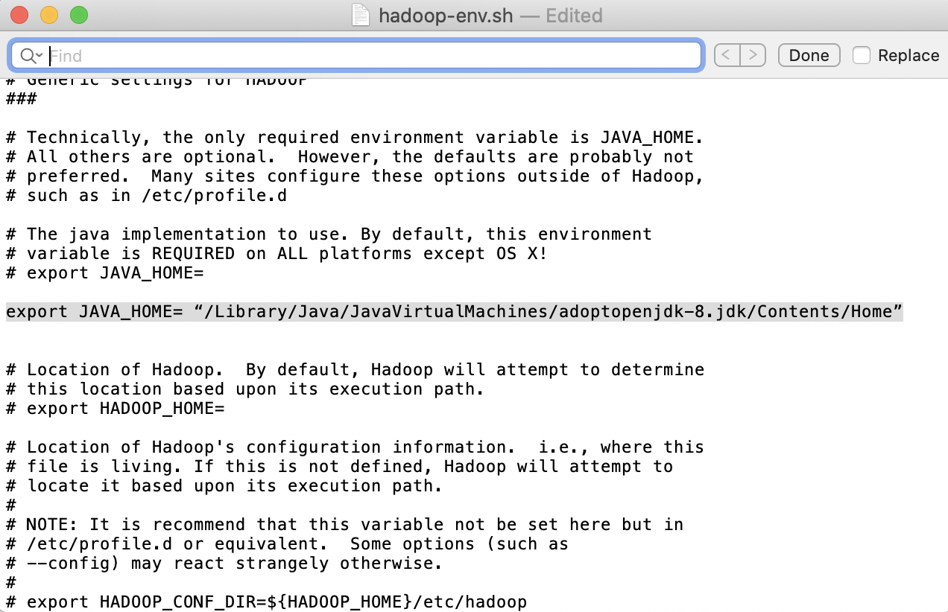
Add the following to hadoop-env.sh
export JAVA_HOME= “/Library/Java/JavaVirtualMachines/adoptopenjdk-8.jdk/Contents/Home”

Slide 7
Then open core-site.xml
$ open -e core-site.xml
Then replace the empty <configuration></configuration> with the following
<configuration> <property> <name>fs.defaultFS</name> <value>hdfs://localhost:9000</value> </property> </configuration>

Slide 8
Then open hdfs-site.xml
$ open -e hdfs-site.xml
Then replace the empty <configuration></configuration> with the following
<configuration> <property> <name>dfs.replication</name> <value>1</value> </property> </configuration>

Slide 9
Then open mapred-site.xml
$ open -e mapred-site.xml
Then replace the empty <configuration></configuration> with the following
<configuration> <property> <name>mapreduce.framework.name</name> <value>yarn</value> </property> <property> <name>mapreduce.application.classpath</name> <value>$HADOOP_MAPRED_HOME/share/hadoop/mapreduce/*:$HADOOP_MAPRED_HOME/share/hadoop/mapreduce/lib/*</value> </property> </configuration>

Slide 10
Then open yarn-site.xml
$ open -e yarn-site.xml
Then replace the empty <configuration></configuration> with the following
<configuration> <property> <name>yarn.nodemanager.aux-services</name> <value>mapreduce_shuffle</value> </property> <property> <name>yarn.nodemanager.env-whitelist</name> <value>JAVA_HOME,HADOOP_COMMON_HOME,HADOOP_HDFS_HOME,HADOOP_CONF_DIR,CLASSPATH_PREPEND_DISTCACHE,HADOOP_YARN_HOME,HADOOP_MAPRED_HOME</value> </property> </configuration>

Slide 11
Remove password requirement
Check if you are able to ssh without a password by typing
$ ssh localhost
If it requires passwd, then use the following commands one at a time to remove the needs
$ ssh-keygen -t rsa -P '' -f ~/.ssh/id_rsa $ cat ~/.ssh/id_rsa.pub >> ~/.ssh/authorized_keys $ chmod 0600 ~/.ssh/authorized_keys

Slide 12
Format Namenode
Issue the following commands to format the namenode
$ cd /usr/local/cellar/hadoop/3.3.0/libexec/bin $ hdfs namenode -format

Slide 13
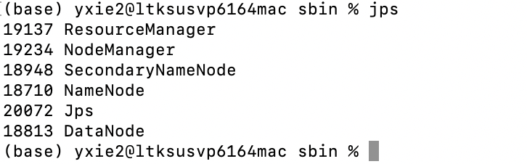
Run Hadoop
$ cd /usr/local/cellar/hadoop/3.3.0/libexec/sbin $ ./start-all.sh $ jps
When the above commands are successfully run, you should see something like the following

Slide 14
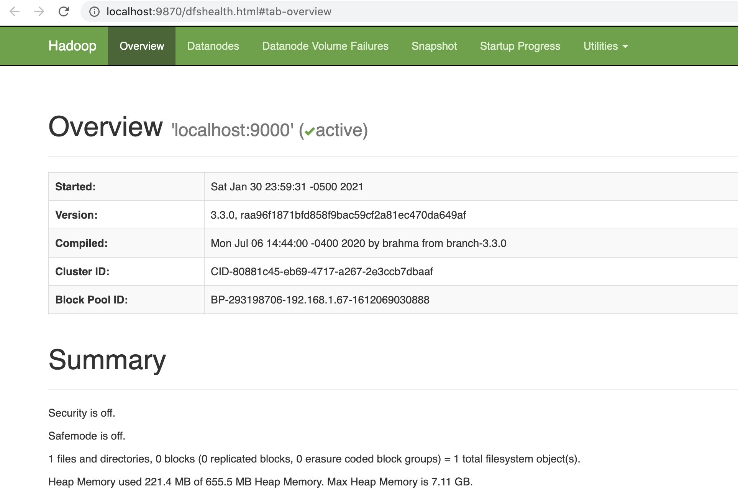
Access http://localhost:9870 in a browser

Slide 15
Close Hadoop
$ cd /usr/local/cellar/hadoop/3.3.0/libexec/sbin
$ ./stop-all.sh

